Slide 1
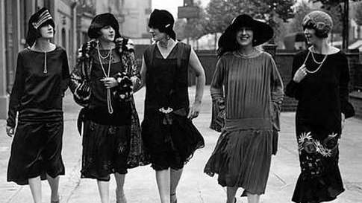
History Heroes
Week 7

Slide 2
1. Which groups in US society did not share in the prosperity of the 1920s? (2 groups, 2 marks)

Slide 3
2. Who was Alphonse Capone? (1 mark)

Slide 4
3. State one group/movement in US society who campaigned for Prohibition. (1 mark)

Slide 5
4. State two groups in society the KKK opposed during the 1920s resurgence period (2 marks).

Slide 6
ANSWERS

Slide 7
1. (2 marks) Farmers Blacks, Asians, Hispanics and American Indians The unemployed Immigrants Catholics and Jews

Slide 8
2. (1 mark) An American gangster and businessman who attained notoriety during the Prohibition era

Slide 9
3. (1 mark) Anti-Saloon League Women’s Christian Temperance Movement

Slide 10
4. 2 marks African-Americans Communists Immigrants Jews

Slide 11
/6

Slide 12

Source of the week

Slide 13
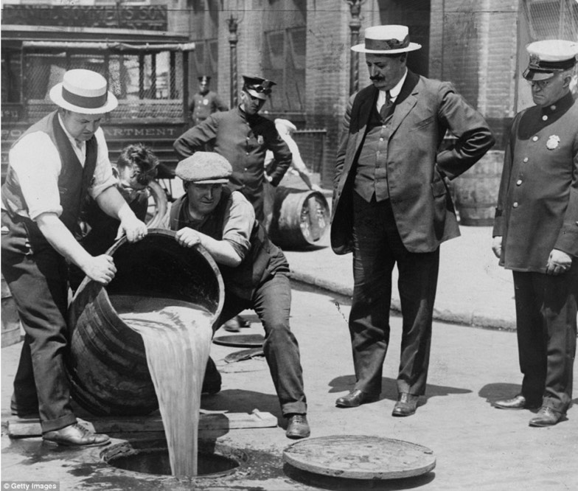
1920s, USA

